Slide 1
DIGITAL PORTFOLIO
STUDENT NAME : Tamilselvi A
REGISTER NO AND NMID : 24131210500122048/asanm121anm1212421347
DEPARTMENT : BCA
COLLEGE : Immaculate college for women
UNIVERSITY : Annamalai

Slide 2
PROJECT TITLE
Student Portfolio

Slide 3

AGENDA
Problem Statement
Project Overview
End Users
Tools and Technologies
Portfolio design and Layout
Features and Functionality
Results and Screenshots
Conclusion

Slide 4

PROBLEM STATEMENT
The lack of the Personalized Platform to showcase academic achievements skills and project create.
Challenge for students During internship jobs application and academic evaluations.

Slide 5

PROJECT OVERVIEW
The project focuses creating a responsive student portfolio website using HTML CSS and JavaScript.
The portfolio is designed to professionally showcase personal information academic qualification and skills.
The main goal is to develop a visually engaging user-friendly and device-responsive platforms.

Slide 6
END USERS
Student - to showcase their academic and technical profile.
Recruiter - to evaluate student skills achievements and project.
Faculty - to access student progress and provide academic reference.
General Audience - to gain on overview of the student background and expertise.

Slide 7

TOOLS AND TECHNIQUES
HTML - for content structure
CSS - for styling and layout
JavaScript - for interactive and dynamic features
Code pen - as the development environment
GitHub - for version control and development

Slide 8

PORTFOLIO DESIGN AND LAYOUT
The responsive layout ensures optimal assess on both desktop and mobile device maintaining consist visual aesthetic.

Slide 9
FEATURES AND FUNCTIONALITY
Clearly defined set education for me, education skills and resume.
A content for with link integration for easy communication.
GitHub integration to display and access responsibilities.
User-friendly interface features clean typography and an organized layout.

Slide 10
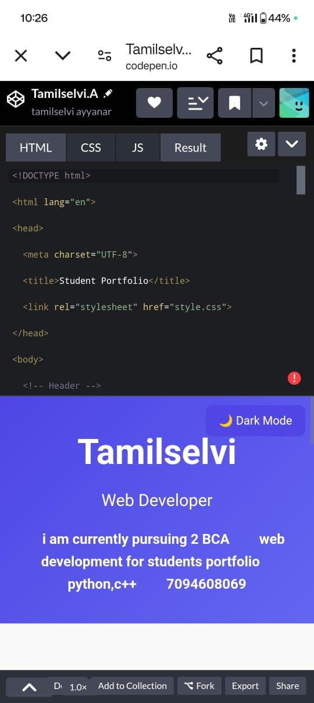
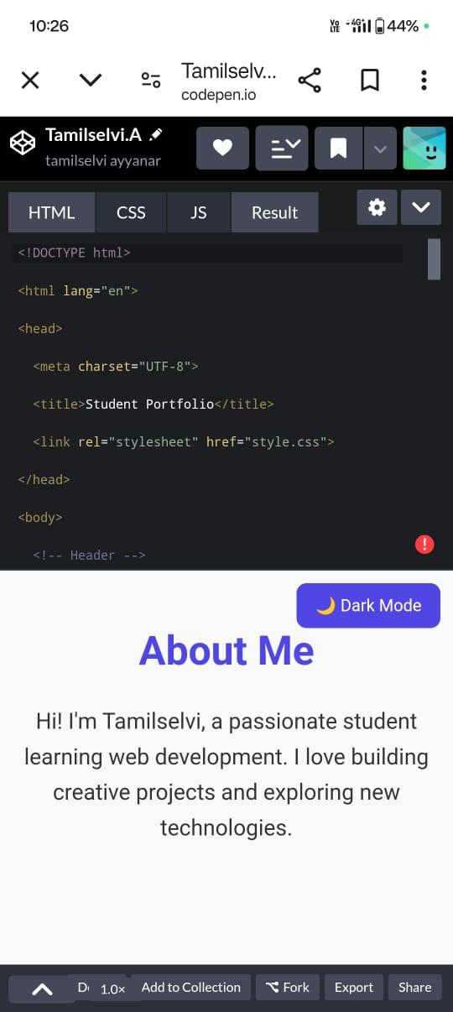
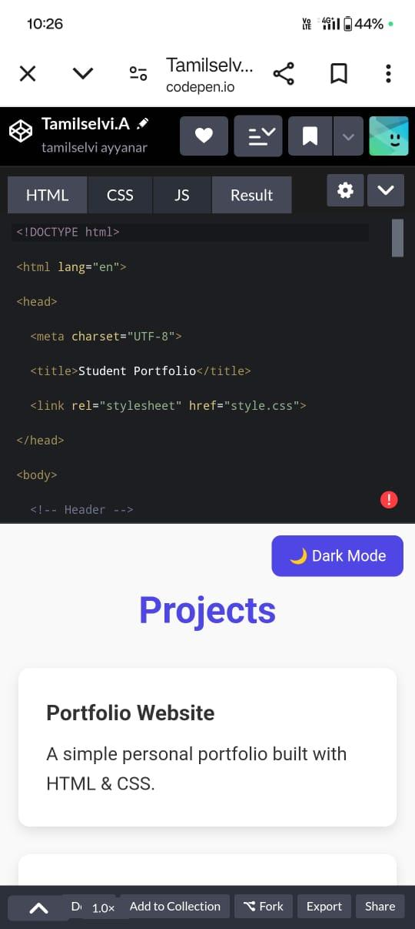
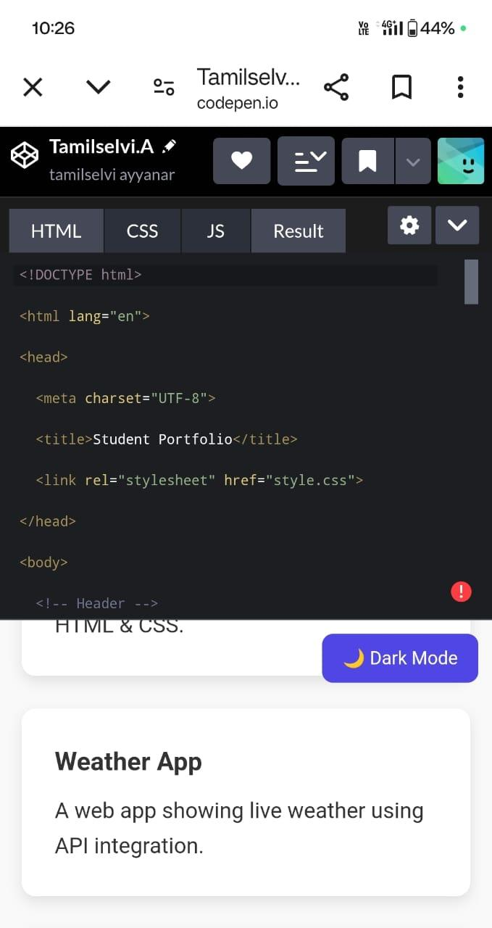
RESULTS AND SCREENSHOTS

Slide 11
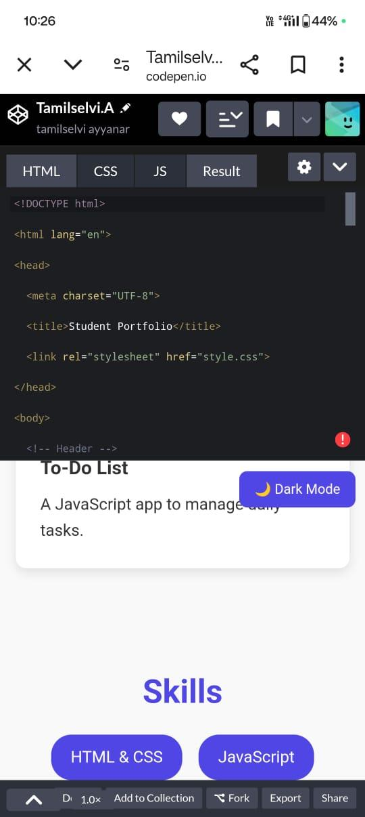
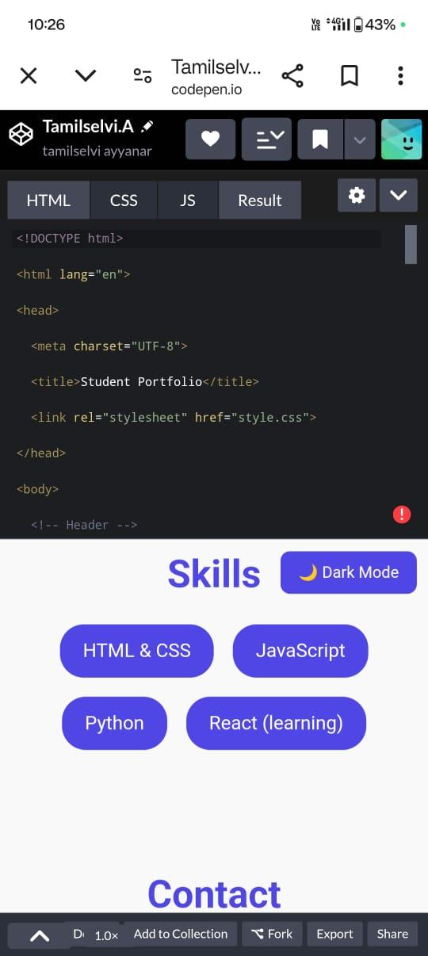
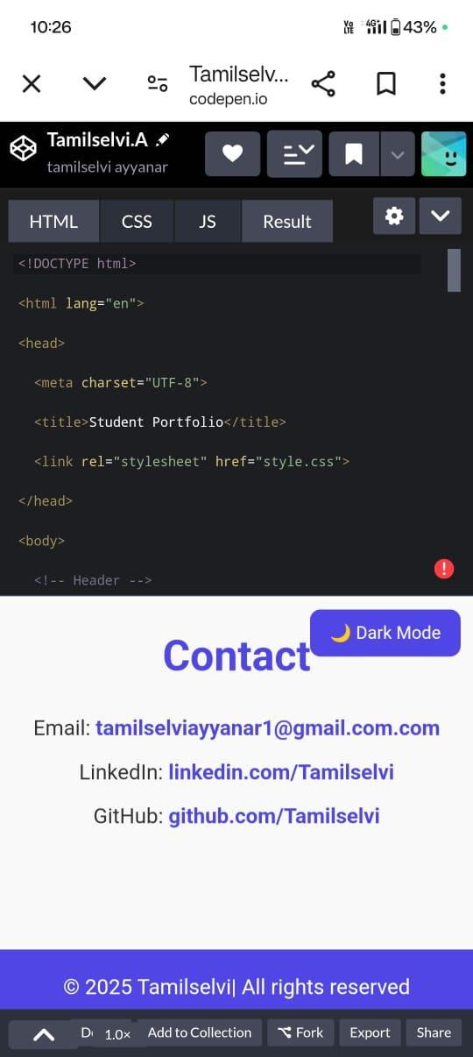
RESULTS AND SCREENSHOTS

Slide 12
CONCLUSION
The portfolio website successfully address the limitations of traditional resume by providing interface assignment and professional platform to represent academic and technical accomplishments.

Slide 13
Thank You

